Slide 1
Managing Partnership
An Introductory guide

Slide 2
MARKET DRIVERS
With Digital Economy Service provider collaborating complex ecosystem.
They deliver connectivity, processing, storage, applications, and content as well as enabling capabilities range of functions such as connectivity, processing, storage, applications, and content
As well as Security ( AAA ) , billing, customer care, service aggregation, and so on.
Communications service providers seeking new offerings for their customers and new uses for their assets.
Managing relationships with other providers and delivering quality services end-to-end across a complicated ecosystem is a core competency for success in the digital world
Three types of relationships with third-party service providers – outsourcing, managed services, and partnerships.

Slide 3
MARKET DRIVERS- contd.
Focus on your core business or access to new solutions, technology, knowledge, talent, or operational expertise.
Restructuring cost base; improving quality; reduce time to market; and standardization. better risk management, Tax advantages
Meet strategic goals like gaining competitive advantage, enhancing the customer experience, gaining agility, flexibility, and sustainable, operational efficiencies,

Slide 4
Word of Caution
Thinking about using outsourcing or managed services just as a convenient way to cut costs usually ends in failure.
Lowest cost may mean lowest quality and least flexibility.

Slide 5
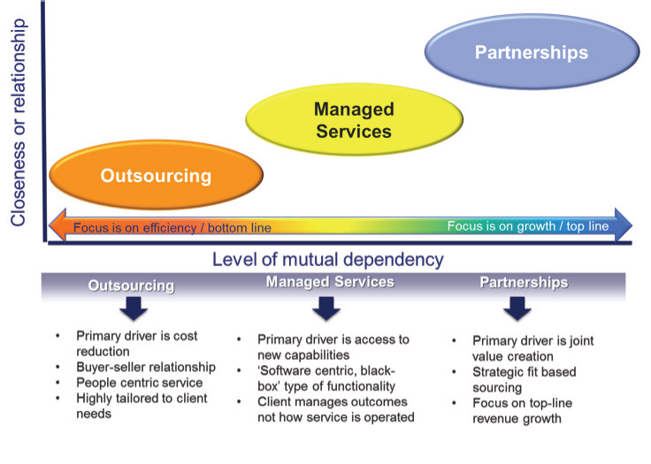
PARTNERHHIPs, MANAGED SERVICES, AND OUTSOURCING

Slide 6
OUTSOURCING
Outsourcing (as opposed to in-sourcing or ‘doing-it-yourself’) is an approach best used in non-critical or highly commoditized situations.
It is often an arms-length relationship and belongs to a world of business models where one party dominates in the relationship and the balance is stacked in favor of the buyer
Value of most outsourcing contracts based on exploiting arbitrage in labor rates by employing people with lower wage scales in emerging economies to assume functions and positions within a buyer’s company.
Outsourcing does not address the problems that buyers tried to transfer to another in the hopes that they would solve them. The adage is true: You cannot outsource your problems.

Slide 7
MANAGED SERVICES
Managed services are usually technology or process centric and rely on specialization and economies of scale to work.
Networking is the original managed service: stick voice or data in at one end and it comes out the other without the user having to worry about capital investment, operations, maintenance, and so on.
With the growth of ‘X as a Service’ (e.g. Software as a Service – SaaS; Infrastructure as a Service – IaaS; and Platform as a Service – PaaS), the managed service concept is rapidly mushrooming and is typically an online ‘black-box’ service, provided either within the same company or sourced from a third party.

Slide 8
Partnerships
Partnerships take this several steps further and are a deeper relationship where both parties work closely towards a mutually beneficial end.
Partnerships between Intel and Microsoft have been mutually beneficial for a long time.
The partners expose their plans and directions to each other and work closely to ensure that both sides of the relationship benefit for such close cooperation.
A partnership is trust between the parties: something that is earned slowly and easily destroyed.
‘digital’ partnerships tend to be more about leveraging capabilities, knowledge, and the expertise of each partner to create virtual services. Application stores, cloud computing/storage, applications services, and M2M automation (e.g. health, security, connected car, connected city, education) are becoming the norm, offering the potential for a huge growth in players offering specialized, niche services because they can exploit some advantage of place, scale, or skill and can do it faster, cheaper, and better than can be done conventionally.

Slide 9
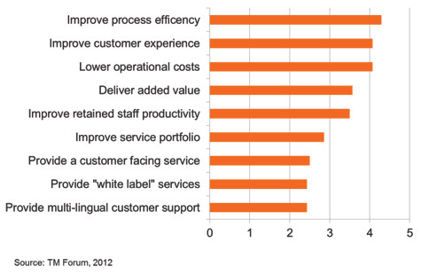
Driver for using managed service

Slide 10
Horizontal and Vertical Partnership
Horizontal collaborations can be between competitive firms within a specific industry to maximize the use of resources for efficiency and to cooperate for competitive advantage.
For example The federated communication approach of roaming partners is one type of horizontal partnership.
The airline industry has the Sky Team, Star Alliance, and One World groupings that enable airlines to operate globally in a coordinated manner.
Vertical partnerships, agreements, and collaborations are those within an ecosystem where partners work together to deliver a service or product seamlessly to an end consumer
The partnerships include the patient, medical personnel, pharmacies, hospitals, data storage centers, network providers, and insurance companies

Slide 11
4 main partnership situations
Sell To: You are the supplier, your partner is a reseller or a customer
Sell Through: Your partner is the channel to market
Sell Of: You are the retailer and your partner is a supplier
Sell With: You and your partner sell a common offering through a subsidiary or together

Slide 12
Operationally managing a relationship - the ‘what,’ not the ‘how’
When you own and run your own service delivery infrastructure, you can decide in great detail how every aspect of your environment should be operated, which processes to use, and which metrics to measure.
In a managed services or partnership relationship, it is important to be much less concerned how your partner does something and much more interested in the outcome, i.e. the what, and treat the service as a black box.
Example is electricity service – it just arrives and all you care about is that the current, voltage, frequency, and price are as agreed in the contract, not how it is generated or transmitted.
Cloud-based solutions, as an example of a fast delivery mechanism for virtualized solutions, are expanding in functionality and scope very rapidly and range from content to applications to platforms and infrastructure – all delivered as services.
sourcing strategy for critical services should be part of the corporate strategy.

Slide 13
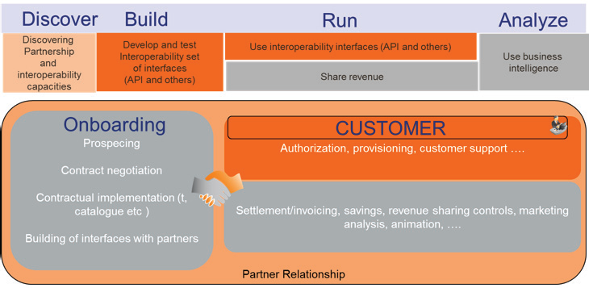
Typical managed service/partner technical relationship functions

Slide 14
KEY SUCCESS FACTORS
Be clear about where partners fit into your strategy
WHY is a partner being considered for the corporation? Define the problem that this approach will solve.
WHAT are the expected business outcomes of the relationship, and what are the targets that will define success?
WHO should perform the services? Which services will be retained in-house, and which will be sourced from which partner? will be responsible for the end-to-end delivered service, and how is assurance going to be engineered in this new operating model?
HOW should the service be delivered to ensure maximum value? The degree of customization in a managed service will drive cost, affect partners ability to meet your business goals, and determine the ease of innovative.
WHERE should the services be performed? How should the delivery of services be distributed, and what are the implications?

Slide 15
KEY SUCCESS FACTORS – Contd.
Understand shared responsibility and trust
Choose your partner with great care
Spend the time to get the details right
Pay great attention to the transition process and beyond

Slide 16
Some rules of thumb
DO: YOUR HOMEWORK
DO: BUILD TRUST
DO: FOCUS ON THE WHAT, NOT THE HOW.
DO: HAVE A PROPER GOVERNANCE STRUCTURE IN PLACE.
DO: MAKE SURE YOU HAVE COMMITMENT
DO: EXPECT RESISTANCE
DO: REVISIT THE TERMS OF THE CONTRACT REGULARLY
ENSURE KEY PEOPLE ARE EMBEDDED WITH YOUR PARTNER
USE STANDARDIZED BUSINESS PROCESSES AND INTERFACES
ENSURE YOU NEGOTIATE FLEXIBILITY INTO THE CONTRACT
CONSIDER YOUR CUSTOMER’S EXPERIENCE AT ALL TIMES.
USE MANAGED SERVICES AS A QUICK FIX.
BE ’PENNY WISE, POUND FOOLISH’
MEASURE MINUTIAE
PLAY THE ZERO-SUM GAME
ALLOW THE ‘HONEYMOON EFFECT’.

Slide 17
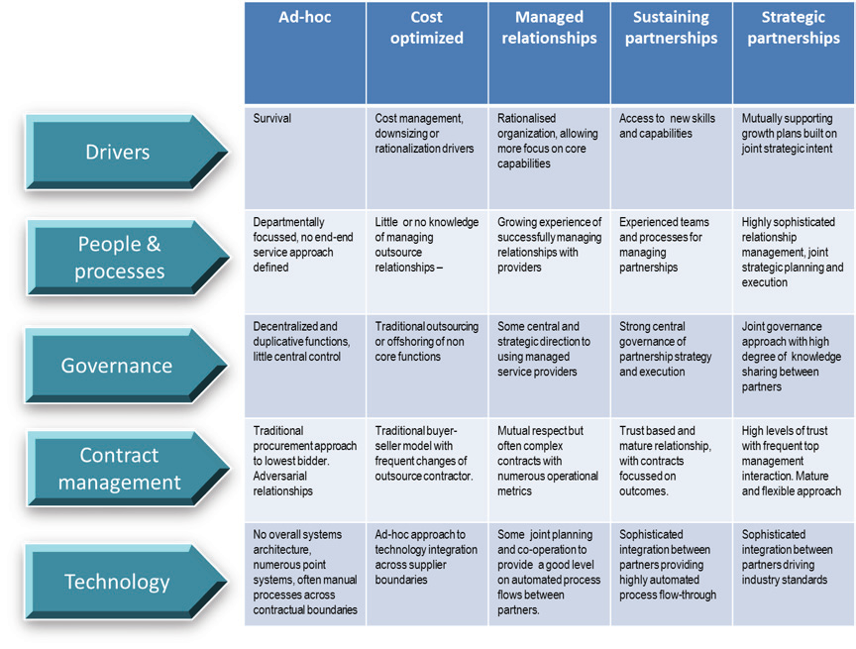
Partnership Maturity Model

